Slide 1

Gokaraju Rangaraju Institute of Engineering and Technology
(Autonomous)
Department of Data Science
Mini Project Work
(CSE(DS))
Review 3&4: Module Presentation & Execution Cycle 1 Presentation
Batch No -10
Presented By:
1.Abhinav U (22241A6767)
2.Jasti Amit (22241A6793)
3.Medhansh K (22241A6799)
Under the Guidance of:
Dr. Mamidi Kiran Kumar
Associate Professor
Department of Data Science

Slide 2
Smart Investment Planner using ML

Slide 3
Abstract
This project assists investors in making data-driven investment decisions by analyzing historical stock data from YFinance. It retrieves stock prices for selected companies and computes key financial metrics, including annualized returns, volatility, and the Sharpe ratio. Based on user inputs such as investment amount, duration (short-term or long-term), and risk tolerance, the system recommends a suitable company by filtering stocks according to risk-adjusted return metrics and estimating potential gains. Additionally, the project features a visualization component that plots historical stock prices, helping investors assess market trends. YFinance data includes historical and real-time stock prices, company fundamentals, financial statements, and valuation metrics, enabling informed investment decisions while considering market risks.

Slide 4
Problem Statement
Investors often face challenges in selecting the best stocks based on their investment capacity, risk tolerance, and investment duration. Additionally, the high volatility of stock prices and real-time market fluctuations make it difficult to make informed decisions. Traditional forecasting methods may not effectively capture the nonlinear and non-stationary nature of stock price movements, leading to inaccurate predictions.To address this challenge, Hilbert-Huang Transform (HHT) and Temporal Convolutional Network (TCN)-based stock prediction model is developed. The model first decomposes stock price trends using EMD to extract relevant features, helping to capture underlying patterns in the data. It then leverages TCN to learn historical price patterns and predict future stock prices with improved accuracy.

Slide 5
Objectives
Live Market Data Integration – Fetch real-time stock prices to ensure recommendations are based on the latest market trends.
Extracting the Intrinsic Mode function using the Hilbert-Huang Transform (HTT) and advanced algorihtms.
Forecasting the trends using the advanced techniques like Temporal convulation Network
Risk Assessment – Categorize stocks based on risk levels and align them with the investor’s risk tolerance.

Slide 6
Hardware and Software Requirements
Hardware Requirements
Software Requirements
Operating System:
Windows 10/11 (64-bit)
macOS (10.15 Catalina or later)
Linux (Ubuntu 18.04 or later)
Processor (CPU): Intel Core i5 (or equivalent) and above (Recommended: Intel Core i7 or AMD Ryzen 5 and above)
Memory (RAM): Minimum 8GB (Recommended: 16GB or higher for better performance)
Python Version: Python 3.7 or later
Storage: Minimum 10GB free space (Recommended: SSD for faster performance)
Required Python Libraries

Slide 7
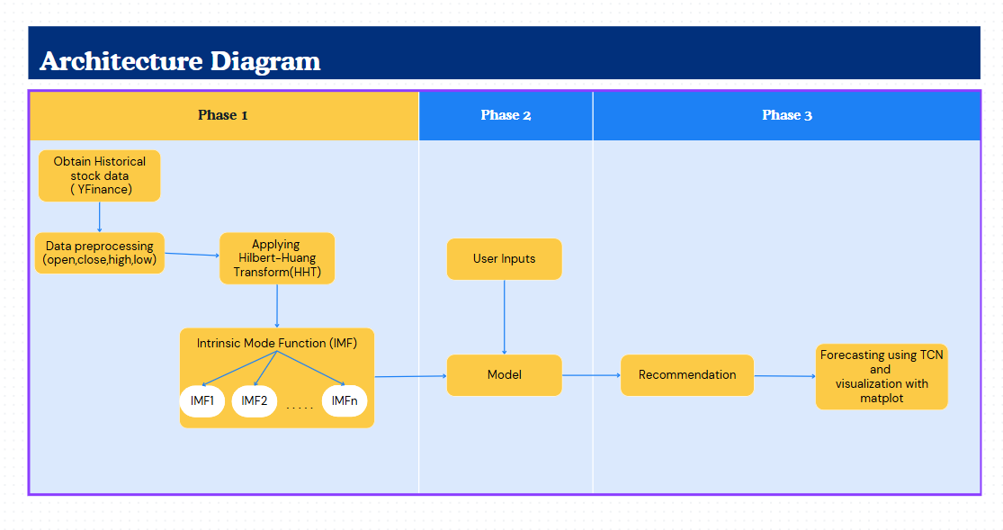
Architecture Diagram

Slide 8
Research Gaps
Reliance on Historical Data:
Some models does not integrate with the real time market movements and prices
Many existing models primarily depend on historical stock data without incorporating real-time data.
Lack of Hybrid Models:
Several studies focus on either traditional statistical models (like ARIMA) or basic ML models (like SVM or LSTM), but rarely explore hybrid approaches.
Short-term & Long-term Predictions:
Most papers mainly focuses on short-term predictions but does not address long-term investment strategies.
Risk Assessment Integration:
While accuracy is a focus, few models integrate risk metrics (like volatility or the Sharpe ratio) directly into stock recommendations.
Our model addresses this by suggesting stocks based on both risk-adjusted returns and user-specific risk tolerance.

Slide 9
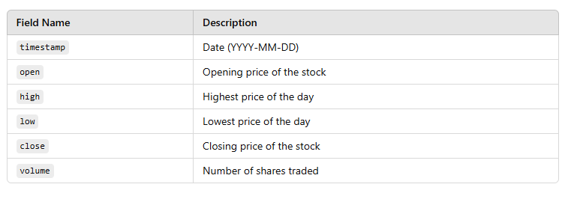
Dataset Details
Dataset Link:https://www.alphavantage.co/documentation/
Dataset Fields:

Slide 10
Source | Research Objective or Research Question | Methodology | Key Findings | Techniques | Accuracy & Performance Measures | Advantages | Disadvantages
Predicting Stock Market Trends Using Machine Learning and Deep Learning Algorithms Via Continuous and Binary Data; Analysis
Improve stock trend prediction accuracy by analyzing both continuous and binary financial data using ML and DL models.
Deep learning models outperform traditional ML models by effectively capturing complex patterns in mixed data formats.
Utilizes ML models (SVM, Random Forest) and DL models (LSTM, CNN) with continuous and binary data for trend classification.
87%–94% trend prediction accuracy.
Decision Tree, Random Forest, Naive Bayes, K-Nearest Neighbors
Enhanced Predictive
Performance And More Accurate
High Cost
&
More Complexity
A Novel Integrated Approach for Stock Prediction Based on Modal Decomposition Technology and Machine Learning
Enhance stock prediction accuracy by integrating modal decomposition with machine learning.
LSTM (Long Short-Term Memory), CEEMDAN
The hybrid model improves forecasting precision by effectively reducing noise and capturing market trends.
Combines modal decomposition (e.g., EMD, VMD) with ML models like LSTM, SVM, or XGBoost.
85%–93% trend prediction accuracy.
Improved Predictive
Performance ,
Effective
Noise Reduction
&
Provides Consistent performance
Computational Complexity
&
Limited Pattern Exploration
A systematic review of stock market prediction using ML and statistical techniques
Overview of ML and statistical techniques in stock prediction.
Reviewed 30 papers covering ML and statistical techniques.
ANN and NN are widely used in prediction.
ANN, Statistical Methods
75% trend prediction accuracy.
Highlights the power of ANN and NN.
Lacks performance comparison

Slide 11
Source | Research Objective or Research Question | Methodology | Key Findings | Techniques | Accuracy & Performance Measures | Advantages | Disadvantages
Machine learning approaches in stock market prediction: A systematic literature review
Reviewed 30 studies on ML models like SVM and Neural Networks.
Neural networks are commonly used for stock prediction.
Review ML techniques in stock prediction.
Neural Networks, SVM
84% trend prediction accuracy.
Provides a broad ML review for stock prediction.
No empirical performance data.
Stock market prediction using machine learning: A study on the Indian stock market
Used historical stock data, financial news, and ML models like LSTM and SVM.
Analyze and predict the Indian stock market.
Social indicators improve stock market predictions.
Uses multiple data sources for better accuracy.
LSTM, SVM, KNN, Random Forest
Achieved minimized RMSE error.
Computationally expensive.
A systematic review of stock market prediction using ML and statistical techniques
Overview of ML and statistical techniques in stock prediction.
Reviewed 30 papers covering ML and statistical techniques.
ANN and NN are widely used in prediction.
ANN, Statistical Methods
75% trend prediction accuracy.
Highlights the power of ANN and NN.
Lacks performance comparison

Slide 12
Source | Research Objective or Research Question | Methodology | Key Findings | Techniques | Accuracy & Performance Measures | Advantages | Disadvantages
The Stock Exchange Prediction using ML Techniques: A Systematic Review
Identify research trends, datasets, and models in stock prediction.
Analyzed 81 studies focusing on classification and estimation.
Classification and estimation are the most used methods.
Classification, Estimation, Clustering
Provides an in-depth trend analysis.
No model performance evaluation.
Approx 77% Accuracy
Stock Market Prediction Using ML Techniques
Compared models like LSTM, XGBoost, and ARIMA on Tesla stock.
Compares multiple ML models.
Predict stock trends using ML models.
LSTM had the best prediction accuracy.
LSTM, XGBoost, ARIMA
85% trend prediction accuracy.
High computational cost.
Applied Linear Regression, Decision Trees, and SVM on historical data.
Dataset limitations affect generalization.
Stock Market Prediction Using Advanced ML
Analyze stock data and predict future trends.
SVM performed better than other models.
Linear Regression, SVM, Decision Trees
Approx 79% Accuracy
Proves ML effectiveness in finance.

Slide 13
Source | Research Objective or Research Question | Methodology | Key Findings | Techniques | Accuracy & Performance Measures | Advantages | Disadvantages
A Survey of ML-Based Approaches for Stock Market Prediction
Compared various ML methods for stock forecasting.
Deep learning models show high predictive power.
Comprehensive review of ML in stock forecasting.
No empirical performance data.
Review ML techniques for stock forecasting.
Various ML Models
~80% trend prediction accuracy.
Stock Market Prediction using ML Algorithm
Predict stock market trends using ML models.
Used LSTM on historical stock data for trend prediction.
LSTM achieved 84% accuracy in trend forecasting.
Shows LSTM’s ability to capture trends.
Focuses only on LSTM, limiting comparison
LSTM, RNN
Approx 84% Accuracy
A Deep Learning-Based Approach for Stock Market Prediction
Deep learning models outperform traditional methods.
High computational cost for training.
Explore deep learning for stock forecasting.
Applied CNN-LSTM hybrid models on historical data.
CNN-LSTM outperformed traditional ML models.
CNN, LSTM, Hybrid Deep Learning Models
~87% trend prediction accuracy.

Slide 14
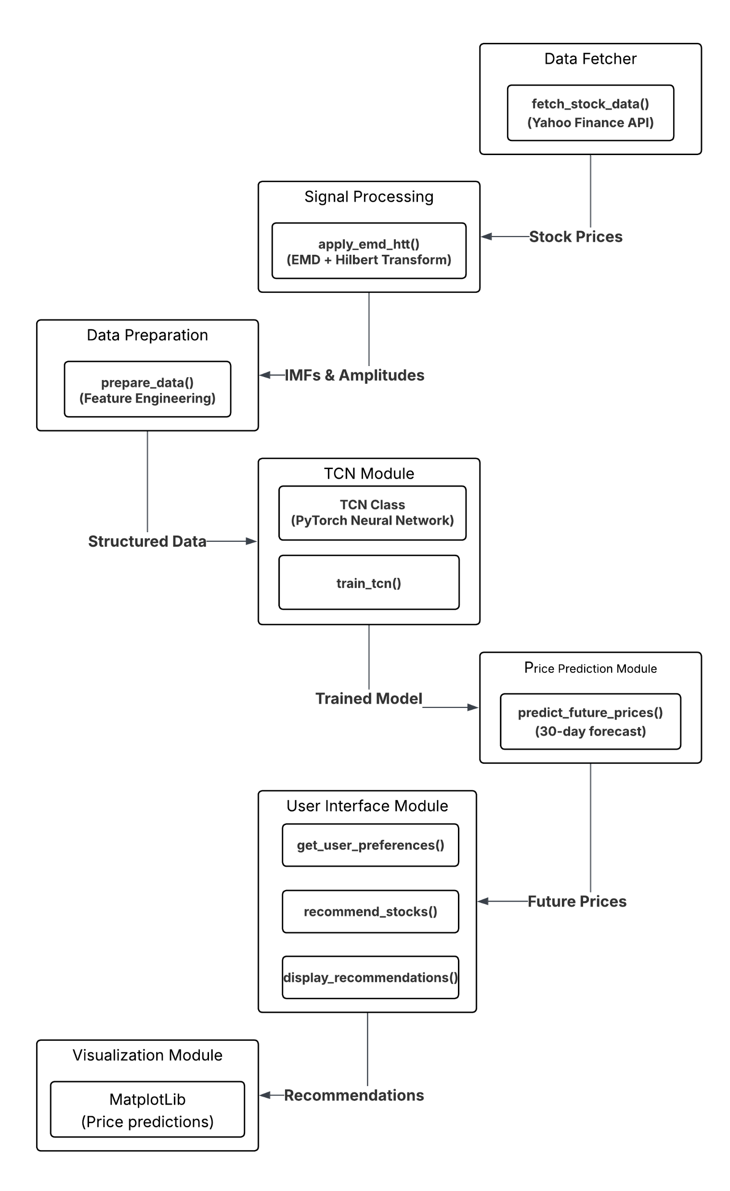
Module Connectivity Diagram

Slide 15
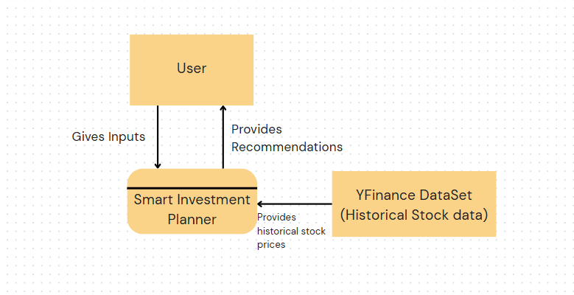
Level 0 DataFlow Diagram

Slide 16
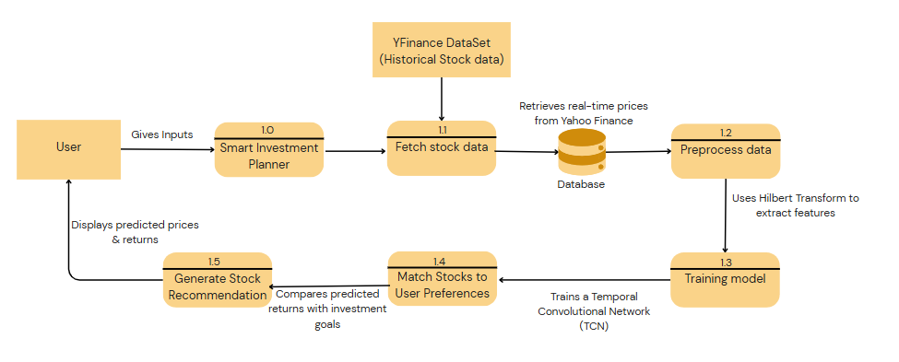
Level 1 DataFlow Diagram

Slide 17
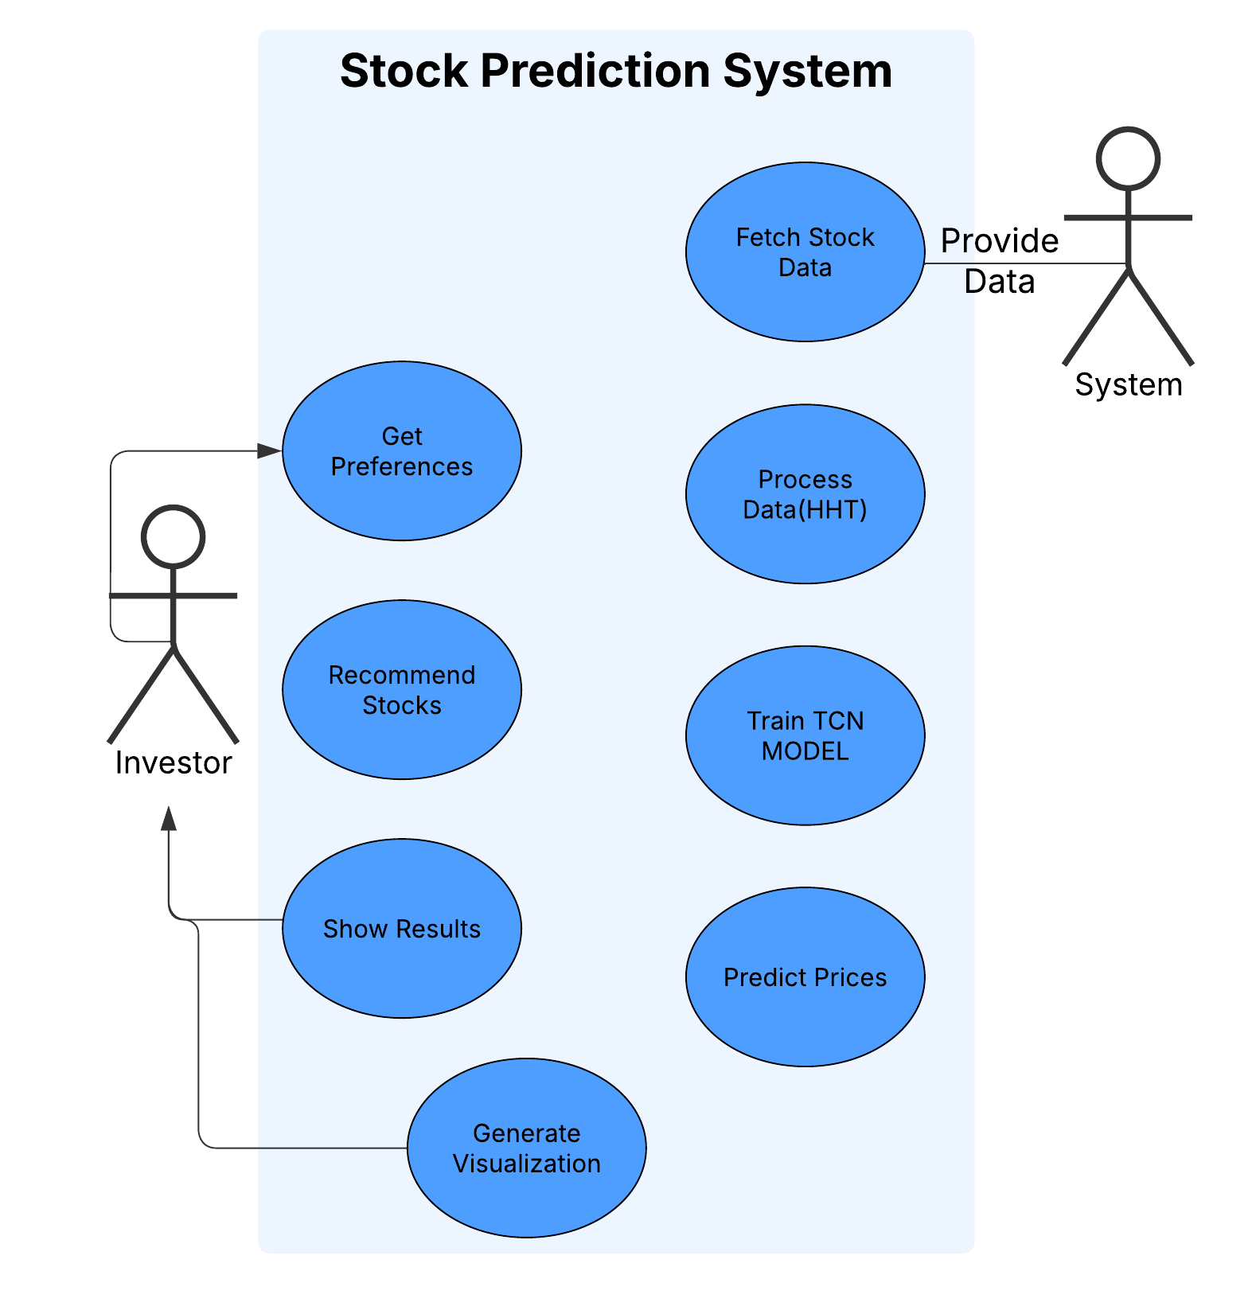
Use Case Diagram

Slide 18
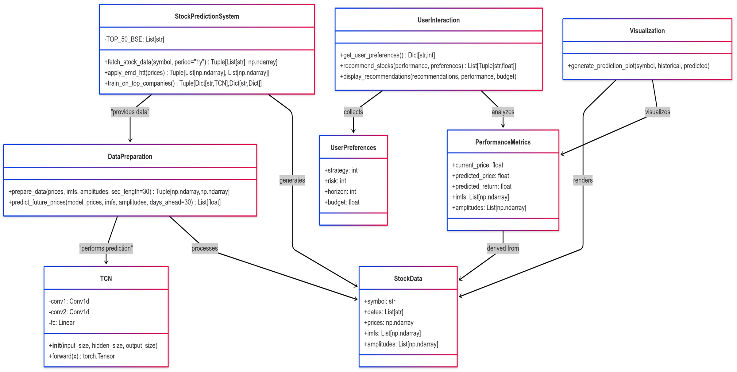
Class Diagram

Slide 19
Coding Standards:
PEP8: Followed PEP8 Python style guide for code formatting.
Modularization: Each function is modular and does one specific task.
FunctionNames: Used snake_case for functions (fetch_stock_data, train_tcn, recommend_stocks).
Class Names: Followed PascalCase for class definitions (e.g., TCN).
Variable Names: Used meaningful variable names like prices, imfs, amplitudes, preferences, etc.
Indentation: Consistent 4-space indentation is used.
Comments: Inline comments and docstrings are used to describe logic.
Software Used:
LucidChart
MS Paint
Microsoft ppt
Google Collab

Slide 20
Standards for Implementing the code
Naming Conventions
Variables and Functions: Used snake_case (e.g., fetch_stock_data, train_on_top_companies)
Classes: Used PascalCase (e.g., TCN)
Constants: Used UPPER_CASE (e.g., TOP_50_BSE)
Comments and Documentation
In-line comments used to explain logic in important or complex parts.
Section comments like # Fetch stock data, # Training function for TCN help navigate the code.
Code Readability
Indentation: 4 spaces per level (PEP 8 compliant).
Line lengths kept within 80-100 characters when possible.

Slide 21
TC001: Verify if the system fetches stock data from the correct API
Test Case ID | TC001 | Test Case | Verify if the system fetches stock data from the correct API
Description | Check whether the fetch_stock_data() function correctly uses the yfinance API and returns data. | Test Priority | High
Pre-Requisite | Internet connection, yfinance library installed | Post-Requisite | None
Test Execution Steps:
S.No | Action | Inputs | Expected Output | Actual Output | Test Browser | Test Result
1 | Call fetch_stock_data() | 'TCS.NS' | List of valid dates and prices | List of valid dates and prices | CLI | Pass
TC002: Check if the system handles API failures and missing data.
Test Case ID | TC002 | Test Case | Check if the system handles API failures and missing data
Description | Ensure system gracefully handles empty/missing data from the yfinance API. | Test Priority | Medium
Pre-Requisite | yfinance installed, simulate invalid stock symbol | Post-Requisite | None
Test Execution Steps:
S.No | Action | Inputs | Expected Output | Actual Output | Test Browser | Test Result
1 | Call fetch_stock_data() offline | 'TCS.NS' (No internet) | Exception caught or handled | Graceful handling via exception | CLI | Pass

Slide 22
TC003: Validate the correctness of fetched stock prices and historical data.
Test Case ID | TC003 | Test Case | Validate correctness of fetched stock prices and historical data
Description | Check the logical structure and range of the returned historical data. | Test Priority | High
Pre-Requisite | yfinance working, valid stock symbol | Post-Requisite | None
Test Execution Steps:
S.No | Action | Inputs | Expected Output | Actual Output | Test Browser | Test Result
1 | Call fetch_stock_data() | 'INFY.NS' | Dates are sequential, prices are floats, no missing entries | Dates and prices fetched correctly, match expectations | CLI | Pass
2 | Check length of prices array | 'INFY.NS' | > 200 entries (1-year data) | 252 entries (approx), consistent with 1 year trading days | CLI | Pass

Slide 23
Test Cases
TC001: Verify if the system fetches stock data from the correct API.
TC002: Check if the system handles API failures and missing data.
TC003: Validate the correctness of fetched stock prices and historical data.
TC004: Verify if the system correctly decomposes stock prices using EMD.
TC005: Validate if HTT (Hilbert Transform Time Series) is applied correctly.
TC006: Ensure the model accepts input features and trains without errors.
TC007: Verify model accuracy using test data.
TC008: Check if overfitting is controlled with proper regularization.
TC009: Validate predictions with real stock market trends.
TC010: Ensure the system handles missing or incomplete data gracefully.
TC011: Verify if the recommendations align with user risk preference.
TC012: Check if stock recommendations update dynamically based on live prices.
TC013: Ensure users can select investment amount and risk level.
TC014: Validate UI displays correct recommendations based on user input.

Slide 24
Experimental Results
The results demonstrated that the system was able to effectively identify stocks with strong upward momentum. For instance, companies like TCS, HDFC Bank, and Infosys showed significant predicted price increases over the next 30 days, with returns estimated between 8% and 11%. These predictions aligned with recent bullish trends in their historical data, showing the model's ability to detect consistent growth patterns.
Additionally, the recommendation system considered the user’s investment amount and risk appetite to suggest optimal stock quantities to purchase, making the results not only accurate but also personalized. Lower-risk investors were guided toward stable, blue-chip stocks, while higher-risk investors received suggestions for high-volatility, potentially high-return equities.

Slide 25
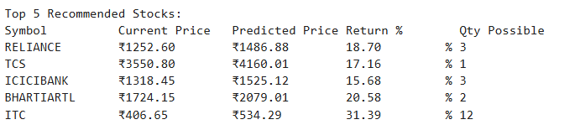
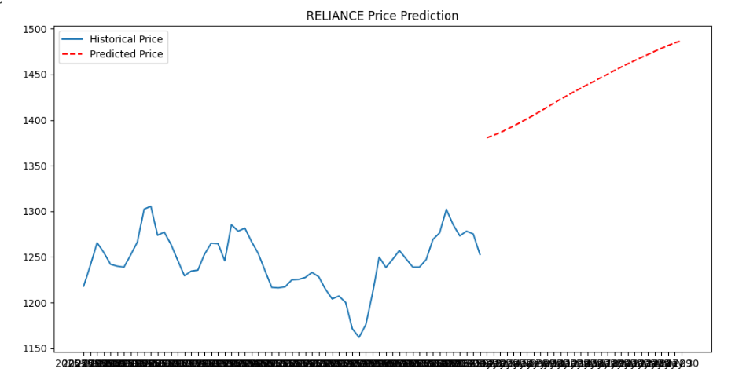
Screenshots of Results

Slide 26
Conclusion
In conclusion, the project effectively combines advanced signal processing and deep learning techniques to develop a smart and adaptive stock recommendation system. By leveraging the Hilbert-Huang Transform (HHT), the system extracts meaningful patterns from non-linear and non-stationary stock price data, while the Temporal Convolutional Network (TCN) accurately learns temporal dependencies to forecast future prices. This hybrid approach not only enhances prediction accuracy but also provides a deeper understanding of market trends. The model further integrates user preferences such as risk appetite, investment horizon, and strategy to offer personalized investment suggestions. Overall, the solution demonstrates a powerful and practical approach to intelligent financial decision-making, paving the way for more informed and data-driven stock investments.

Slide 27
Future Enhancements
Integration with More Data Sources:
Enhance accuracy by integrating data from multiple stock exchanges (e.g., NYSE, NASDAQ, BSE, NSE).
Include macroeconomic indicators (inflation, GDP growth, interest rates) to improve predictions.
Blockchain for Secure Transactions:
Use blockchain technology for secure stock trading and investment tracking.
Ensure transparency in data collection and prevent manipulation.
Integration with More Data Sources:
Enhance accuracy by integrating data from multiple stock exchanges (e.g., NYSE, NASDAQ, BSE, NSE).
Include macroeconomic indicators (inflation, GDP growth, interest rates) to improve predictions.

Slide 28
References
S. Palit and C. S. Roy, "Stock Market Prediction Using Machine Learning," IOSR Journal of Computer Engineering (IOSR-JCE), vol. 22, no. 4, pp. 8–17, Jul.–Aug. 2020.
D. Kumar, P. K. Sarangi, and R. Verma, "A Systematic Review of Stock Market Prediction Using Machine Learning and Statistical Techniques," Materials Today: Proceedings, vol. 49, no. 1, pp. 1565–1570, Jan. 2022, doi: 10.1016/j.matpr.2020.11.399.
R. B. Wiranata and A. Djunaidy, "The Stock Exchange Prediction using Machine Learning Techniques: A Comprehensive and Systematic Literature Review," Jurnal Ilmu Komputer dan Informasi, vol. 14, no. 2, pp. 91–112, Jul. 2021, doi: 10.21609/jiki.v14i2.935.
M. Durairaj and B. H. Krishna Mohan, "A convolutional neural network based approach to financial time series prediction," Neural Computing and Applications, vol. 34, no. 14, pp. 11599–11614, Jul. 2022, doi: 10.1007/s00521-022-07000-1.

Slide 29
A. Moghar and M. Hamiche, "Stock Market Prediction Using LSTM Recurrent Neural Network," Procedia Computer Science, vol. 170, pp. 1168–1173, 2020, doi: 10.1016/j.procs.2020.03.049.
L. Kumar, A. Pandey, S. Srivastava, and M. Darbari, "A Hybrid Machine Learning System for Stock Market Forecasting," Journal of International Technology and Information Management, vol. 20, no. 1, pp. 39–50, 2011
M. Durairaj and B. H. Krishna Mohan, "A convolutional neural network based approach to financial time series prediction," Neural Computing and Applications, vol. 34, no. 14, pp. 11599–11614, Jul. 2022, doi: 10.1007/s00521-022-07000-1.

Slide 30

Thank You
Thank You

